Slide 1

DSC ML Talks: Introduction to Machine Learning

Slide 2
What is the first thing
that comes to your mind
when your hear the word
Machine Learning?
Notes:
What other examples of ML in general lives can you think of? Drop them in the chatbox!

Slide 3
Well, if we talk about the Sci-Fi movies, Machine Learning and Artificial Intelligence involve killer sentient Skynet robots out here to destroy humanity, or driverless vehicles. Sounds futuristic, right?
Well not so much. Machine Learning is not something futuristic. Machine Learning is already here, and has been here since decades.
In fact, you are surrounded by Machine Learning right now. The spam filter in your G-Mail, the movie recommender on Netflix or Amazon Prime, or the smart assistant on your phone. These are nothing but Machine Learning in our day-to-day lives.
Notes:
What other examples of ML in general lives can you think of? Drop them in the chatbox!

Slide 4
So, what exactly is Machine Learning?
Notes:
What other examples of ML in general lives can you think of? Drop them in the chatbox!

Slide 5
Machine Learning is the science (and art) of programming computers so they can learn from data.
Here is a slightly more general definition:
Machine Learning is the field of study that gives computers the ability to learn without being explicitly programmed. —Arthur Samuel, 1959
And a more engineering-oriented one:
A computer program is said to learn from experience E with respect to some task T and some performance measure P, if its performance on T, as measured by P, improves with experience E. —Tom Mitchell, 1997
Notes:
If I download the entire Wikipedia database on my computer, does that count as my machine learning something? Well, if we look at the definition

Slide 6
Let’s try to understand ML with the help of some illustrations…
Notes:
What other examples of ML in general lives can you think of? Drop them in the chatbox!

Slide 7
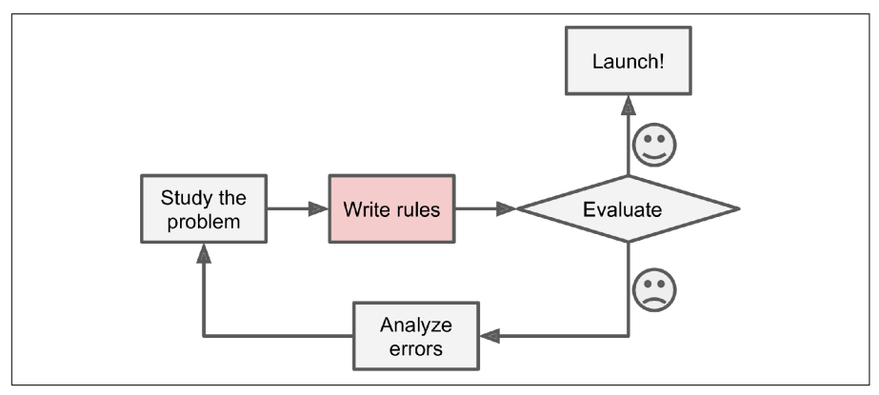
The Traditional “Manually” Programmed Algorithm:
Let us suppose that you are working on creating a spam filter for your mails. Here, we assume that there is no such thing as Machine Learning and you will have to manually code the spam filter.

Slide 8
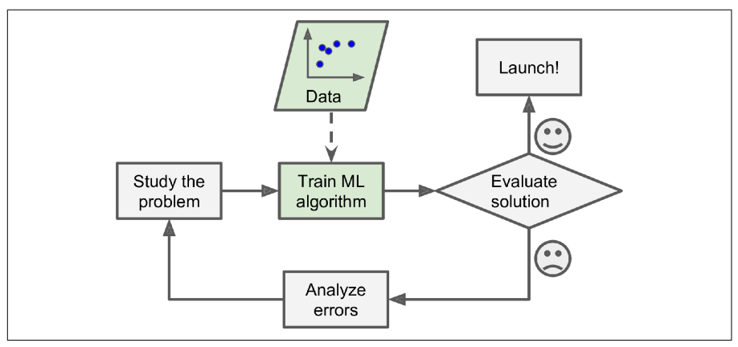
A Machine Learning Algorithm:
Now, let us have a look at the machine learning approach for the same spam filter problem. As you can see here, we have just made a slight change to the diagram. Let’s try to understand this.
Notes:
First up. Just like the previous problem, we have a problem at hand that we want to solve, i.e., creating a spam filter that sorts our emails.
Then, we have some data, basically emails labeled as spam or not spam. A quick note, this will be a labeled dataset. We have another types of data that can be used for training models of different kinds, namely unlabeled data, semi-labeled data, etc.
Now here is how the training process will occur:

Slide 9
Classification of Machine Learning
Notes:
What other examples of ML in general lives can you think of? Drop them in the chatbox!

Slide 10
Machine Learning is a very fast evolving field.
There are hundreds of machine learning algorithms, a new one emerging on the horizon every other day, thanks to the research-oriented and open-source ideology of those working in the field.
Because of this, it is not possible to study all the algorithms. Instead, what we need is a way to sort the algorithms into some classes, and then study those classes as a whole.
Now, there are several ways by which we can classify the ML algorithms. Some of these are discussed in the next few slides.

Slide 11
Criteria for Classifications of ML Algorithms
Notes:
What other examples of ML in general lives can you think of? Drop them in the chatbox!

Slide 12
Whether or not they are trained with human supervision (Supervised, Unsupervised, and Semi-Supervised)
Whether or not they can learn incrementally on the fly (online versus batch learning)
Whether they work by simply comparing new data points to known data points, or instead by detecting patterns in the training data and building a predictive model, much like scientists do (instance-based versus model-based learning)

Slide 13
Human-Supervision Based Classification
Notes:
What other examples of ML in general lives can you think of? Drop them in the chatbox!

Slide 14
Out of all the classification criteria that we discussed in the previous slides, the most important and generally used one is human-supervision based classification of ML algorithms.
In the Machine Learning terminology, human supervision simply infers whether the dataset that is supplied by us, the humans, to our ML model, is labeled or not.
Now, in the above given definition, we came across a few terms, i.e., dataset, model, and labels. Before we go any further, we first need to establish a strong understanding of what these terms mean.
Notes:
Out of all the classification criteria that we discussed in the previous slides, the most important and generally used one is human-supervision based classification of ML algorithms.
So in this session, we will be trying to understand the same in detail.

Slide 15
Some Important ML Terminology
Notes:
What other examples of ML in general lives can you think of? Drop them in the chatbox!

Slide 16
Dataset: Dataset simply refers to the data that you will be using to “train” your ML “model”. This can in the tabular form (CSV or spreadsheets), images, audio data, time-dependent data, etc.
A dataset can further be simplified into smaller entities:
Attributes/Features: A feature can be defined as a value associated with a data instance/object that expresses a trait, or property of that data instance.
Eg.- Let’s consider your mobile phone as an object. The screen size, resolution, battery capacity, etc. are the attributes/features associated with the object phone.
Target/Labels: Label can be defined as the variable that we are trying to predict with the help of our model for a given data instance having a certain set of attributes.
Eg.- Let’s assume you are trying to predict the price of your phone. So in this case, the actual price of the phone will be the target/label.

Slide 17
Features
Target
Screen Size | RAM | Rear Camera(s) | Price
5” | 3 | 3 | 14,999
6.1” | 6 | 3 | 1,29,900
6.89” | 8 | 4 | 58,600
5.8” | 4 | 3 | 18,999
6” | 4 | 2 | 13,400

Slide 18
ML Model: You can say that the term “model” is just a fancy name for the ML algorithm.
Now what is an ML algorithm? An algorithm can be defined as a function, or a set of rules that, given an input X, processes it to generate the output Y.
Same logic goes for an ML algorithm. It is a mathematical function, f, to which we provide some data instance X, which our function processes to generate the output Y.
Training a model: Training a Machine Learning model involves feeding the model function some data, generating predictions for the given input, then evaluating the predictions using some loss function. Then, based on the loss, we update the parameters (weights and biases) associated with the model function.

Slide 19
General ML Model Diagram
Input Data (x)
Model Function
[ F(x) ]
Output (y)
Parameters: The weights and biases associated with the model function. These are the values associated with the model that the model “learns” during the training process.
Hyperparameters: Non-“learnable” variables that the user/ ML engineer sets.

Slide 20
Supervised Learning

Slide 21
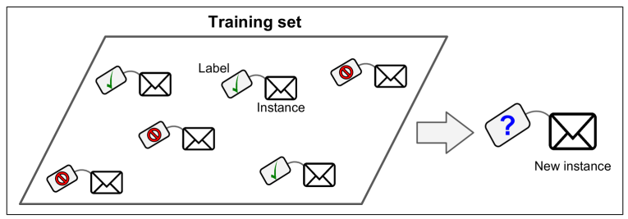
In supervised learning, the data that is used for training the model consists of the label/target variable as well. For example:
In the spam classifier, the training data will contain samples for both spam and non-spam emails.
In the example where we were trying to predict the price of the mobile phone, the price column consisted of the actual price of the mobile phones. Here, the price is the label.

Slide 22
Some Supervised Learning Algorithms:
Here are some of the most important supervised learning algorithms:
• k-Nearest Neighbors • Linear Regression • Logistic Regression • Support Vector Machines (SVMs) • Decision Trees and Random Forests • Deep neural networks

Slide 23
Unsupervised Learning

Slide 24
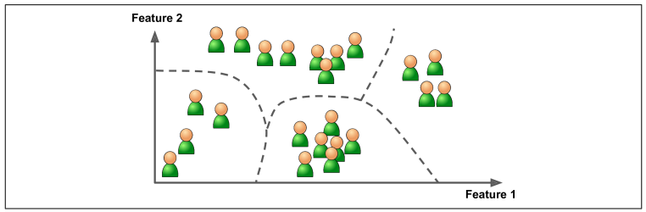
In unsupervised learning, as you can already guess, the training data will not have any labels. You can say that the model will try to learn without any teacher.
One great example of unsupervised machine learning is customer segmentation.
No customer is labeled good or bad, or how much spending power they have, how profitable they might be to the store.
So, the model tries to find some connections based on the customers’ features, and based on these connections, it clusters them into groups.
The store owner can then study these segments, and try to extract some useful insights from it.

Slide 25
Some Unsupervised Learning Algorithms:
Here are some of the most important supervised learning algorithms:
K-Means
DBSCAN
Hierarchical Cluster Analysis (HCA)
One-class SVM
Isolation Forest
Principal Component Analysis (PCA)

Slide 26
Semi-Supervised Learning

Slide 27
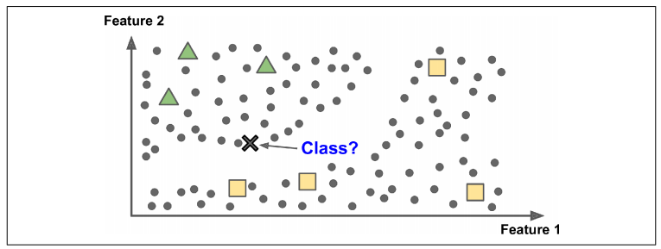
Since labeling data is usually time-consuming and costly, you will often have plenty of unlabeled instances, and few labeled instances.
Some algorithms can deal with data that’s partially labeled. This is called semi-supervised learning.
For ex.- Google Photos organizes photos of people using semi-supervised learning. First of all, it clusters all the photos into folders based on similarity of facial features. Then once you provide a label for a person/folder, all the pictures in that folder gets labeled as that person’s name.

Slide 28
These categories that we just studied about can be further classified into smaller sub-categories.

Slide 29
Thank you

